Slide 1
Object Oriented Programming

Slide 2
Simple Program
class Example
{
public static void main(String args[])
{
System.out.println(“Hello World");
}
}

Slide 3
Lexical Issues
class Example1
{
public static void main(String args[])
{
int a=3,b=3;
c = a+b
System.out.println(“sum" + c);
}
}

Slide 4
Lexical Issues
Java programs are a collection of whitespace, identifiers, comments, literals, operators, separators, and keywords.
whitespace
identifiers
comments
literals
operators
separators
keyworlds

Slide 5
whitespace
Java is a free form language.

Slide 6
identifiers
An identifier may be any descriptive sequence of uppercase and lowercase letters,
numbers or the underscore and dollar-sign characters.
Some examples of valid identifiers are:
AvgTemp count a4 $test this_ is _ ok
Invalid variable names include:
2count high-temp Not/ok

Slide 7
Literals
A constant value in Java is created by using a literal representation of it.
For example, here are some literals:
100 98.6 ‘X’ “This is a test”

Slide 8
comments
// Java single-line comment
/*other Java comment style*/
/* also can go on
for any number of lines*/

Slide 9
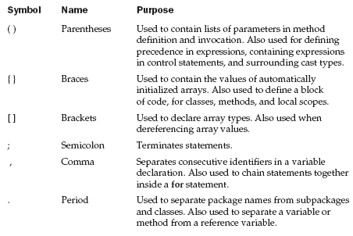
separators

Slide 10
separators

Slide 11
separators

Slide 12
separators

Slide 13
separators

Slide 14
separators

Slide 15
separators

Slide 16
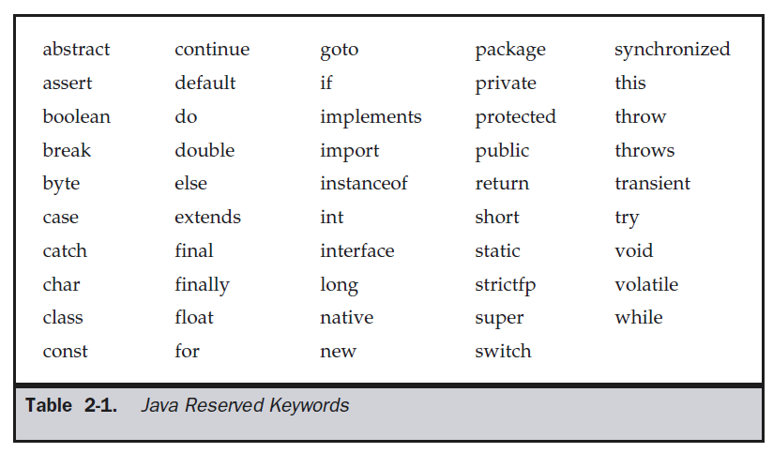
keywords

Slide 17
The Simple Types
Java defines eight simple types of data: byte, short, int, long, char, float, double and boolean.
These can be put in four groups:
Integers This group includes byte, short, int, and long, which are for whole valued signed numbers.
Floating-point numbers This group includes float and double, which represent numbers with fractional precision.
Characters This group includes char, which represents symbols in a character
set, like letters and numbers.
Boolean This group includes boolean, which is a special type for representing
true/false values.

Slide 18
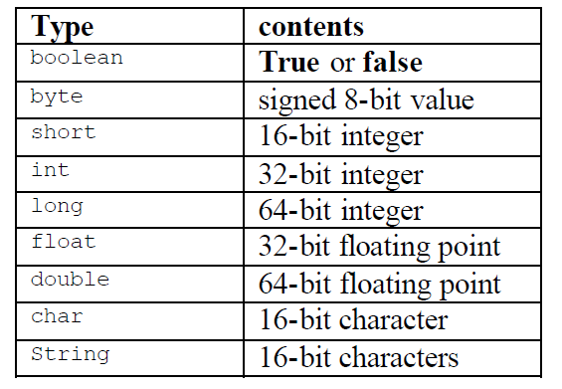

Slide 19
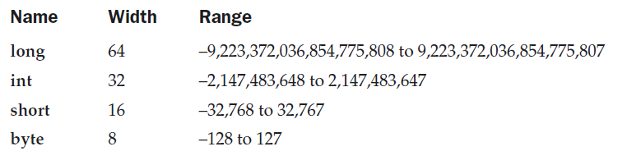
Integer Type

Slide 20
Example
// Compute distance light travels using long variables.
class Light
{ public static void main(String args[])
{
int lightspeed;
long days;
long seconds;
long distance;
// approximate speed of light in miles per second
lightspeed = 186000;
days = 1000;
seconds = days * 24 * 60 * 60;
distance = lightspeed * seconds;
System.out.print("In " + days+ ” days light will travel about”+ distance+ “miles”);
}
}

Slide 21
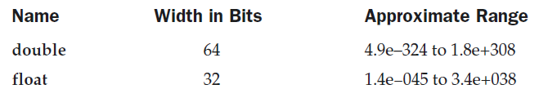
Floating- Point Type

Slide 22
Example
// Compute the area of a circle.
class Area
{
public static void main(String args[])
{
double pi, r, a;
r = 10.8;
pi = 3.1416;
a = pi * r * r;
System.out.println("Area of circle is " + a);
}
}

Slide 23
Character type
// Demonstrate char data type.
class CharDemo
{
public static void main(String args[])
{
char ch1, ch2;
ch1 = 88; // code for X
ch2 = 'Y';
System.out.print("ch1 and ch2: ");
System.out.println(ch1 + " " + ch2);
}
}

Slide 24
// char variables behave like integers.
class CharDemo2
{
public static void main(String args[])
{
char ch1;
ch1 = 'X';
System.out.println("ch1 contains " + ch1);
ch1++; // increment ch1
System.out.println("ch1 is now " + ch1);
}
}

Slide 25
Boolean
class BoolTest
{ public static void main(String args[])
{ boolean b;
b = false;
System.out.println("b is " + b);
b = true;
System.out.println("b is " + b);
if(b) System.out.println("This is executed.");
b = false;
if(b) System.out.println("This is not executed.");
// outcome of a relational operator is a boolean value
System.out.println("10 > 9 is " + (10 > 9));
} }

Slide 26
Literals
Integer Literals
Floating point literals
Boolean literals
Character literals
String literals

Slide 27
Integer literals
decimal : example 4, 7, 89
Octal:
denoted by leading zeros
Example: 02 , 07
error : 09
Hexadecimal:
denoted by leading 0x or 0X
The range of a hexadecimal digit is 0 to 15, so A through F (or a through f ) are
substituted for 10 through 15.

Slide 28
Floating- Point Literals
represent decimal values with a fractional component.
expressed in either standard or scientific notation.
Standard notation : consists of a whole number component followed by a decimal point followed by a fractional component.
For example, 2.0, 3.14159, and 0.6667

Slide 29
Floating- Point Literals
Scientific notation : uses a standard-notation, floating-point number plus a suffix that
specifies a power of 10 by which the number is to be multiplied.
The exponent is indicated by an E or e followed by a decimal number, which can be positive or negative.
Examples include 6.022E23, 12346E05

Slide 30
Boolean literals
Boolean literals are simple.
There are only two logical values that a boolean value can have, true and false.
The values of true and false do not convert into any numerical representation.
The true literal in Java does not equal 1, nor does the false literal equal 0.

Slide 31
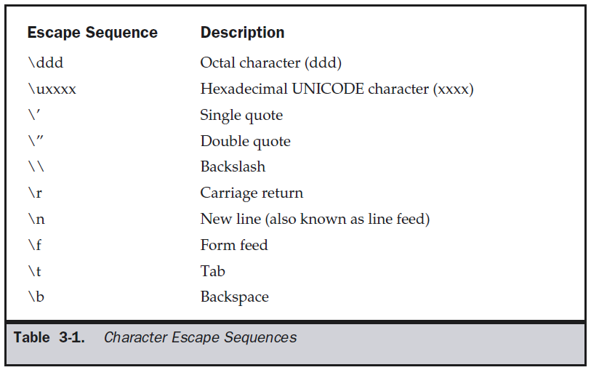
Character Literals

Slide 32
String literals
String literals are specified by enclosing a sequence of characters between a pair of double quotes.
Examples of string literals are
“Hello World”
“two\nlines”
“\”This is in quotes\””

Slide 33
Variables
Declaring a Variable
type identifier [ = value][, identifier [= value] ...] ;
int a, b, c;
int d = 3, e, f = 5;
byte z = 22;
double pi = 3.14159;
char x = 'x';

Slide 34
Dynamic Initialization
// Demonstrate dynamic initialization.
class DynInit
{
public static void main(String args[])
{
double a = 3.0, b = 4.0;
// c is dynamically initialized
double c = Math.sqrt(a * a + b * b);
System.out.println("Hypotenuse is " + c);
}
}

Slide 35
Operators

Slide 36
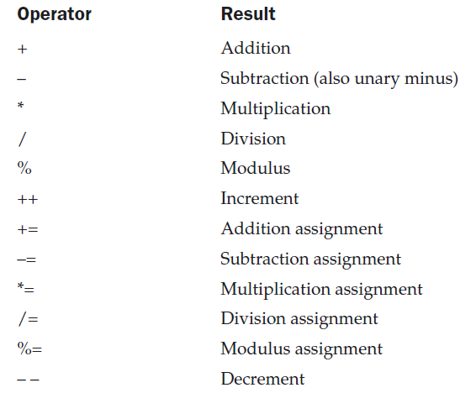
Arithmetic Operators

Slide 37
Example
// Demonstrate the basic arithmetic operators.
class BasicMath
{ public static void main(String args[])
{ System.out.println("Integer Arithmetic");
int a = 1 + 1;
int b = a * 3;
int c = b / 4;
int d = c - a;
int e = -d;
System.out.println("a = " + a);
System.out.println("b = " + b);
System.out.println("c = " + c);
System.out.println("d = " + d);
System.out.println("e = " + e);
} }

Slide 38
The modules operator
// Demonstrate the % operator.
class Modulus
{ public static void main(String args[])
{
int x = 42;
double y = 42.25;
System.out.println("x mod 10 = " + x % 10);
System.out.println("y mod 10 = " + y % 10);
}
}
output:
x mod 10 = 2
y mod 10 = 2.25

Slide 39
Arithmetic Compound Assignment Operators
// Demonstrate several assignment operators.
class OpEquals
{ public static void main(String args[])
{ int a = 1, b = 2;
int c = 3;
a += 5;
b *= 4;
c += a * b;
c %= 6;
System.out.println("a = " + a);
System.out.println("b = " + b);
System.out.println("c = " + c);
}}

Slide 40
Increment and Decrement
// Demonstrate ++.
class IncDec
{ public static void main(String args[])
{ int a = 1, b = 2;
int c, d;
c = ++b;
d = a++;
c++;
System.out.println("a = " + a);
System.out.println("b = " + b);
System.out.println("c = " + c);
System.out.println("d = " + d);
} }

Slide 41
Write a java program to check whether the given number is positive or negative.

Slide 42
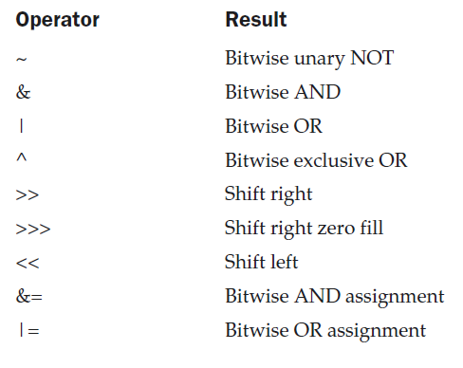
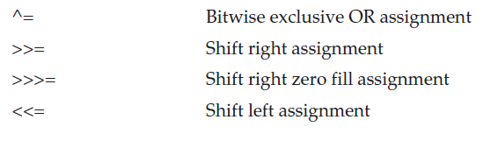
The Bitwise Operators
Bitwise operators can be applied to the integer types, long, int, short, char, and byte.

Slide 43
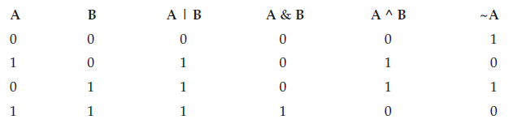
Bitwise logical operator

Slide 44
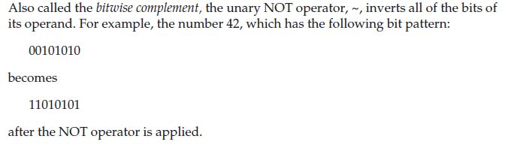
The bitwise Not

Slide 45
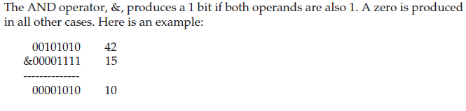
The bitwise AND

Slide 46
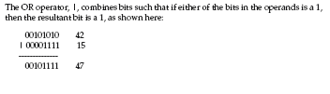
The Bitwise OR

Slide 47
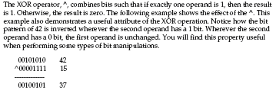
The Bitwise XOR

Slide 48
Example
// Demonstrate the bitwise logical operators.
class BitLogic
{ public static void main(String args[])
{
int a = 3, b = 6;
int c = a | b;
int d = a & b;
int e = a ^ b;
int f = (~a & b) | (a & ~b);
System.out.println(" a = " + a);
System.out.println(" b = " + b);
System.out.println(" a|b = " +c);
System.out.println(" a&b = " + d);
System.out.println(" a^b = " + e);
System.out.println("~a&b|a&~b = " + f);
}
}

Slide 49
Left shift
For each shift left, the high-order bit is shifted out (and lost), and a zero is brought in on the right.
byte a = 64, b;
int i;
i = a << 2;
System.out.println("Original value of a: " + a);
System.out.println(i);

Slide 50
Left shift
For each shift left, the high-order bit is shifted out (and lost), and a zero is brought in on the right.
byte a = 64, b;
b = (byte) (a << 2);
System.out.println("Original value of a: " + a);
System.out.println( b);

Slide 51
OUTPUT :
Original value of a: 64
0

Slide 52
The Right shift
When shifting right, the top (leftmost) bits exposed by the right shift are filled in with the previous contents of the top bit.
This is called sign extension and serves to preserve the sign of negative numbers when we shift them right.
Ex1: int a = 32;
a = a >> 2;
Ex2: int a = 35;
a = a >>2;

Slide 53
OUTPUT :
x :8
y : 8

Slide 54
The Right shift(contd..)
When shifting right, the top (leftmost) bits exposed by the right shift are filled in with the previous contents of the top bit.
This is called sign extension and serves to preserve the sign of negative numbers when we shift them right.
For example, –8 >> 1 is –4, which, in binary, is
11111000 –8
>>1
11111100 –4

Slide 55
Right shift
int a = -1;
a = a >> 24;

Slide 56
Right shift
int a = -1;
a = a >> 24;
Here is the same operation in binary form to further illustrate what is happening:
11111111 11111111 11111111 11111111 –1 in binary as an int
>>24
11111111 11111111 11111111 11111111 -1 in binary as an int

Slide 57
The Unsigned Right shift
int a = -1;
a = a >>> 24;

Slide 58
The Unsigned Right shift
int a = -1;
a = a >>> 24;
Here is the same operation in binary form to further illustrate what is happening:
11111111 11111111 11111111 11111111 –1 in binary as an int
>>>24
00000000 00000000 00000000 11111111 255 in binary as an int

Slide 59
Bitwise Operator Compound Assignments
class OpBitEquals
{ public static void main(String args[])
{
int a = 1, b = 2, c = 3;
a |= 4;
b >>= 1;
c <<= 1;
a ^= c;
System.out.println("a = " + a);
System.out.println("b = " + b);
System.out.println("c = " + c);
a ^= c;
System.out.println("a = " + a);
}
}

Slide 60
a = 5
b = 1
c = 6
a = 3

Slide 61


Relational Operator

Slide 62
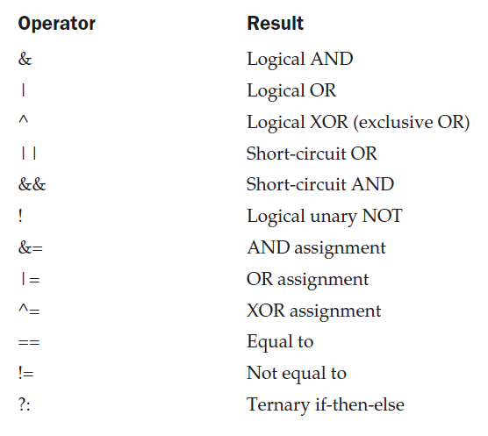
Boolean Logical Operators

Slide 63
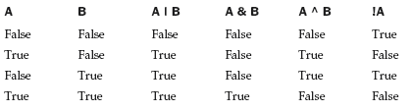

Slide 64
Example
boolean a = true, b = false;
boolean c = a | b;
boolean d = a & b;
boolean e = a ^ b;
boolean f = (!a & b) | (a & !b);
boolean g = !a;
System.out.println(" a = " + a);
System.out.println(" b = " + b);
System.out.println(" a|b = " + c);
System.out.println(" a&b = " + d);
System.out.println(" a^b = " + e);
System.out.println("!a&b|a&!b = " + f);
System.out.println(" !a = " + g);

Slide 65
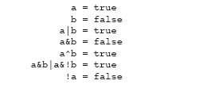

Slide 66
Short-Circuit Logical Operator
if (denom != 0 && num / denom > 10)
if(c==1 & e++ < 100) d = 100;

Slide 67
Short-Circuit Logical Operator
int a=5,b=6;
if(a >1 | ++b > 1)
{
System.out.println("b="+b);
}
int a=5,b=6;
if(a >1 || ++b > 1)
{
System.out.println("b="+b);
}

Slide 68
The Assignment Operator
var = expression;
int x, y, z;
x=y=z=100; // set x, y and z to 100

Slide 69
The ? Operator
int i, k;
i = 10;
k = i < 0 ? -i : i; // get absolute value of i
System.out.print("Absolute value of “+ i + " is " + k);
i = -10;
k = i < 0 ? -i : i; // get absolute value of i
System.out.print("Absolute value of “+ i + " is " + k);

Slide 70
Operator Precedence
int a=2, b=3, c=4,d;
d = a+b-c;
d = a+b*c;

Slide 71
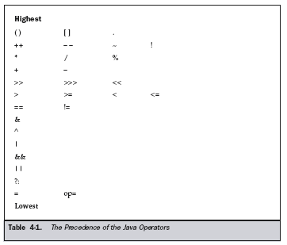
Operator Precedence

Slide 72
int a=128, b=2, x;
x = a >> b + 3;
System.out.println(“x=“ +x);

Slide 73
int a=128, b=2, x;
x = a >> b + 3;
System.out.println(“x=“ +x);
X = 4

Slide 74
Using Parentheses
Parentheses raise the precedence of the operations that are inside them.
consider the expression:
a >> b + 3
This expression first adds 3 to b and then shifts a right by that result. That is, this expression can be rewritten using redundant parentheses like this:
a >> (b + 3)
if you want to first shift a right by b positions and then add 3 to that
result, you will need to parenthesize the expression like this:
(a >> b) + 3

Slide 75
Using Parentheses
int a=128,b=2,x;
x = (a >> b) + 3;
System.out.println(“x =“+x);

Slide 76
Using Parentheses
int a=128,b=2,x;
x = (a >> b) + 3;
System.out.println(“x =“+x);
X = 35

Slide 77
Write a java program to check whether the given number
Is divisible by 7 or not. If not display the next number which is divisible by 7.

Slide 78
Write a java program to find roots of quadratic equation

Slide 79
Reading input from keyboard
int a;
Scanner sc = new Scanner(System.in);
a = sc.nextInt();
import java.util.Scanner;

Slide 80
import java.util.Scanner;
class prg3
{ public static void main(String args[])
{ int a,b,c;
Scanner sc = new Scanner(System.in);
System.out.println("Enter a first number");
a = sc.nextInt();
System.out.println("Enter a second number");
b = sc.nextInt();
c = a+ b;
System.out.println("sum is :"+c);
} }

Slide 81
Arrays
One dimensional array
To create an array we need to perform two steps
1) declare the array
2)allocate space for the elements
1)type varName[];
ex: int a[];
2) varName = new type[size];
a = new int[10];

Slide 82
These two steps may be combined into one java statement as
type varName[] = new type[size];
int a[] = new int [10];
Accessing array: a[2] = 10;
Starts from zeroth position.

Slide 83
Size of the array can be obtained via the following expression.
varName.length

Slide 84
Abbreviated syntax to declare, allocate and initialize the elements of an array.
type varName[] = { e0, e1, …………en };
Here new is not used and sufficient memory is automatically provided.

Slide 85
We may assign array variable to another however, array itself is not physically copied.
Instead the variable on the left side of the assignment will simply refer to the same Array.
int j[] = { 0,1,2,3,4,5};
int k[];
k=j;

Slide 86
class FirstProgram
{
public static void main(String args[])
{
int a[]= {10,20,30};
System.out.println(a[0]);
System.out.println(a.length);
}
}

Slide 87
class FirstProgram
{
public static void main(String args[])
{
int b[] = new int[10];
b[0]=5;
b[1]=6;
System.out.println(b[0]);
System.out.println(b.length);
}
}

Slide 88
class FirstProgram
{
public static void main(String args[])
{
int b[] = new int[10];
b[0]=5;
b[1]=6;
System.out.println(b[0]);
System.out.println(b.length);
}
}
Output: 5, 10

Slide 89
class FirstProgram
{ public static void main(String args[])
{
int a[]= {10,20,30};
int b[];
b= a;
System.out.println("array a = "+a[0]+ " "+a[1]+" "+ a[2]);
System.out.println("array b= " + b[0]+ " "+b[1]+" " +b[2]);
b[1] = 50;
System.out.println("array a = "+a[0]+ " "+a[1]+" "+ a[2]);
System.out.println("array b= " + b[0]+ " "+b[1]+" " +b[2]);
} }

Slide 90
Write a java program to find largest element in an aray

Slide 91
Write a java program to convert decimal to binary

Slide 92
Multidimensional array
In java multidimensional arrays are implemented as arrays of arrays
Declaration
type varName[][];
ex: int a[][];
2)Allocating space
varName = new type[size1][size2];
ex: a = new int[10][10];
OR
type varName = new type [size1][size2];
int a[][] = new int[10][10];

Slide 93
The size of the multidimensional array can be obtained by
varName.length;
To obtain the length of individual array
varName[index].length

Slide 94
Declaration, allocation & initialization
type varName[][] = { { e00, e01,..e0x}, {e10,e11,..e1y},….{e20,e21,…e2z}};
int a[][] = { {10,20,30}, { 4,5}, {1,2,3,4}};

Slide 95
class FirstProgram
{
public static void main(String args[])
{
int a[][]={{10,20,30,40}, { 3,4}, {5,6,7,8,9}};
System.out.println(a[1][1]);
System.out.println(a.length);
System.out.println(a[0].length);
System.out.println(a[1].length);
System.out.println(a[2].length);
}
}

Slide 96
Control statements
Decision making and branching
Simple if statement
Nested if statement
If else statements
Ifelse ladder
Switch statements.

Slide 97
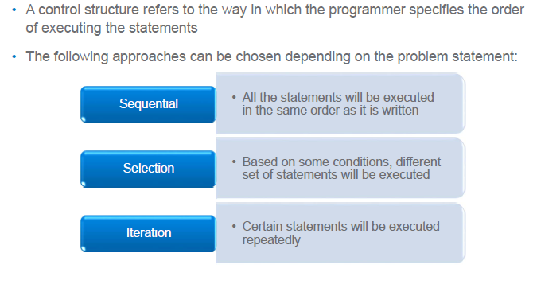
Control structures

Slide 98
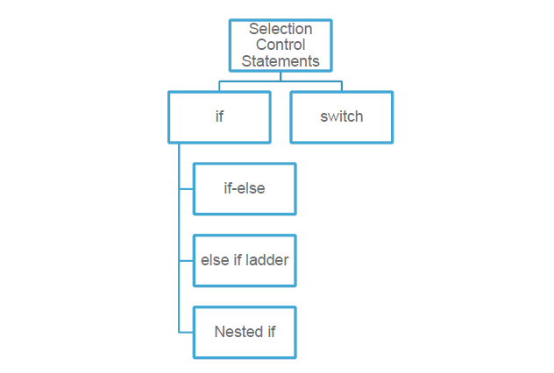
Selection Control structures

Slide 99

Selection Control structures statements
Simple if statement

Slide 100
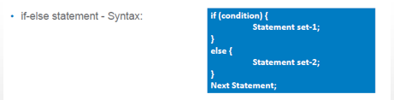
Selection Control structures statements

Slide 101
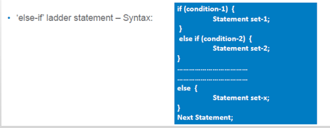
Selection Control structures statements

Slide 102
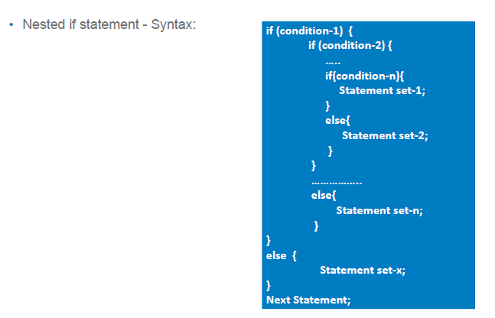
Selection Control structures statements

Slide 103
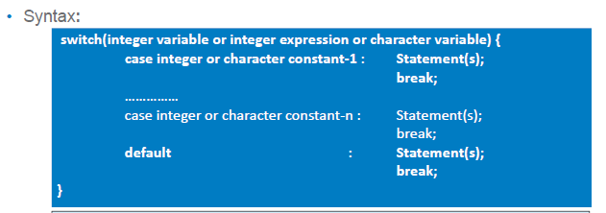
Selection Control structures - switch statement
is a selection control structure that helps to select a choice from a set of available choices.
Expression must be of type byte ,short,int or char
Case must be integer or char

Slide 104
Selection Control structures - switch statement
int number=20;
switch(number)
{
case 10: System.out.println("10");
break;
case 20: System.out.println("20");
break;
case 30: System.out.println("30");
break;
default:System.out.println("Not in 10, 20 or 30");
}

Slide 105
Selection Control structures - switch statement
int number=30;
switch(number)
{
case 10: System.out.println("10");
case 20: System.out.println("20");
case 30: System.out.println("30");
case 40: System.out.println(“40");
default:System.out.println("Not in 10, 20,30 or 40");
}

Slide 106
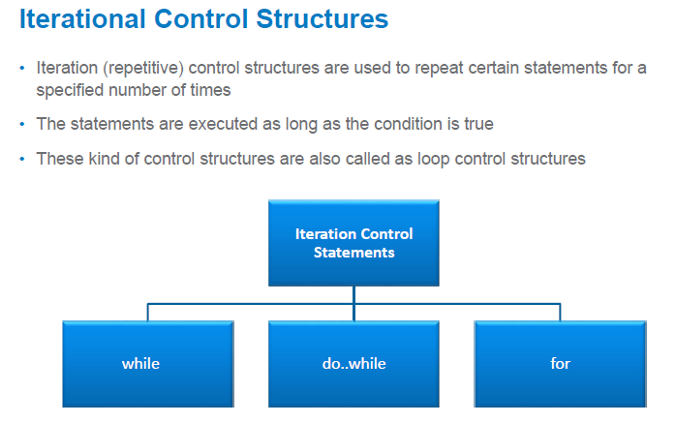

Slide 107

int count = 0;
while (count < 100)
{
System.out.println("Welcome to Java");
count++;
}

Slide 108

int count = 0;
while (count < 2)
{
System.out.println("Welcome to Java!");
count++;
}

Slide 109

int i;
for (i = 0; i < 2; i++)
{
System.out.println( "Welcome to Java!");
}

Slide 110
Control statements
for (type var : list)
{
System.out.println(var);
}

Slide 111
int a[] = {10,20,30};
for (int b : a)
{
System.out.println(b);
}

Slide 112
String s[]= {"anil","sunil","rahul"};
for (String b : s)
{
System.out.println(b);
}

Slide 113
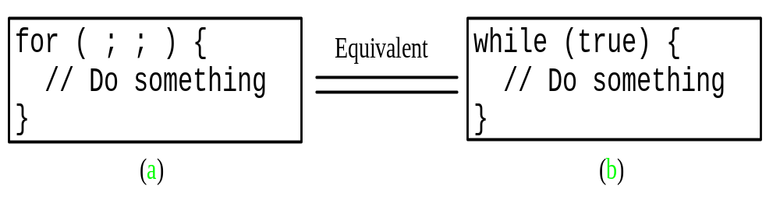

Slide 114


Slide 115

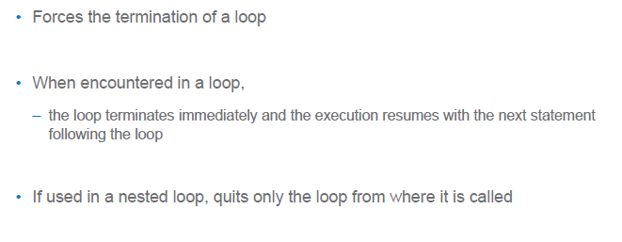

Slide 116

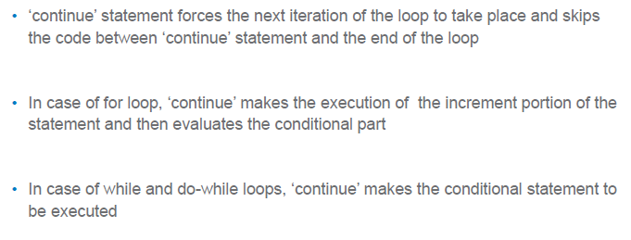

Slide 117
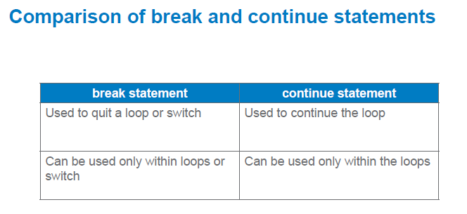

Slide 118
Labeled break and continue statement
mylabel: for(i=0;i<10;i++)
{
for(j=0;j<10;j++)
{
if(i==j)
break mylabel;
}
}

Slide 119
Labeled break and continue statement
mylabel: for(i=0;i<10;i++)
{
for(j=0;j<10;j++)
{
if(i==j)
continue mylabel;
}
}

Slide 120
Labeled break and continue statement
mylabel: for(i=0;i<10;i++)
{
for(j=0;j<10;j++)
{
if(i==j)
break mylabel
}
}
mylabel: for(i=0;i<10;i++)
{
for(j=0;j<10;j++)
{
if(i==j)
continue mylabel
}
}

Slide 121
class prg
{
public static void main(String args[])
{
int a=2,n=3,s=0;
s = pow(a,n)
System.out.println(“s=“+s)
}
static int pow(int b, int n)
{
}
}

Slide 122
Type casting
Process of converting one data type to another is called casting.
4 integer types can be cast into any other type except boolean.
Float and double can be cast to any other type except boolean.
Casting a floating point value to an integer will result in a loss of the fractional part.

Slide 123
Below shows which are guaranteed to result in no loss of information.
From To
byte short, char, int, long, float, double
short int, long, float, double
char int, long, float, double
int long, float, double
long float, double
float double

Slide 124
Automatic conversion : assigning the value of one type to a variable of different type without a cast.
byte b = 75;
int a = b;
The process of assigning a smaller type to a larger one is known as widening or promotion.

Slide 125
Explicit conversion(narrowing)
Assigning a larger type to a smaller one is known as narrowing.
type 1 var1 = (type2) var2
Ex: int a;
double b =3.4;
a= (int) b;

Slide 126
Type conversions in expressions
During evaluation of the expression, if the operands are of different types, lower type is automatically converted to higher type before the operation proceeds.
Whenever a char, byte or short is used in an expression, its value is automatically converted to int during the evaluation of that expression called integral promotion
After the automatic integral promotions are applied, the java compiler converts all operands “up” to the type of the largest operand. This is called type promotion.

Slide 127
It is on an operation-by-operation basis as described in the following type-conversion algorithm.
IF either operand is a double
THEN the other operand is converted to double
ELSE IF either operand is float
THEN the other operand is converted to float
ELSE IF either operand is long
THEN the other operand is converted to long.

Slide 128
The final result of an expression is converted to the type of the variable on the left of the assignment sign before assigning the value to it.
The following changes are introduced during the final assignment.
  1 float to int causes truncation of fractional part.
  2 double to float causes rounding of digits.
  3 long to int causes dropping of the excess higher order bits.

Slide 129
class Promote
{ public static void main(String args[])
{
byte b = 42; char c = 'a';
short s = 1024; int i = 50000;
float f = 5.67f; double d = .1234;
double result = (f * b) + (i / c) - (d * s);
System.out.println("result = " + result);
}}

Slide 130
First subexpression, f * b, b is promoted to a float and the result of the subexpression is float.
In the subexpression i / c, c is promoted to int, and the result is of type int.
Then, in d * s, the value of s is promoted to double, and the type of the subexpression is double.
Finally, these three intermediate values, float, int, and double, are considered.
The outcome of float plus an int is a float. Then the resultant float minus the last double
is promoted to double, which is the type for the final result of the expression.

Slide 131
byte a=2, d=3;
short c;
c= a+d;

Slide 132
byte a=2, d=3
short c;
c= a+d;
Error: found: int required short.
------------------------------------------------------------------------------------------------
Correct:
byte a=2, d=3
short c;
c= (short)(a+d)

Slide 133
byte b;
int i=258;
b = (byte)i;
System.out.println(b);

Slide 134
byte b;
int i=258;
b = (byte)i;
System.out.println(b);
OUTPUT: 2

Slide 135
float f=23.99f
int i=(int)f;
System.out.println(i);

Slide 136
float f=23.99f
int i=(int)f;
System.out.println(i);
OUTPUT: 23

Slide 137
byte b1 =1;
byte b2 = 2;
byte b3 = b1 * b2;
System.out.println(b3);
ERROR

Slide 138
byte b=50;
short t;
t = b
NO ERROR
-----------------------------------------------------------------------------------------------
byte b=50;
short t;
t = b - 1
ERROR : found : int
required : short

Slide 139
int n=386;
byte b;
b = (byte)n;
System.out.println(b);

Slide 140
int n=386;
byte b;
b = (byte)n;
System.out.println(b);
Output : -126

Slide 141
OUTPUT : -126
386= 110000010
10000010
01111101
1
--------------
2s complement 01111110 = 126
So value is -126

Slide 142
class prg
{
public static void main(String args[])
{
int a=2,n=3,s=0;
s = pow(a,n)
System.out.println(“s=“+s)
}
static int pow()
{
}
}

